Slide 1
Car Price Prediction
Using Linear Regression

Slide 2
Aim
To impute missing value in the Automobile Company data
To predict car prices.

Slide 3
Methodology
Exploratory Data Analysis
Modelling
Model Evaluation
Final Submission

Slide 4
Exploratory Data Analysis
Missing Value imputation
Missing value in normalized loss which is average loss payment per insured vehicle is imputed using its mean value.
Missing value in price is imputed using its mean value.
Missing value in bore which is a diameter of each cylinder is imputed using its mean value.
Missing value in stroke which is amount of movement of piston can move up and down is imputed using its mean value.
Missing value in number of doors is imputed using its mean value.
Missing value in horsepower is imputed using its mean value.
Missing value in peak-rpm is imputed using its mean value.

Slide 5
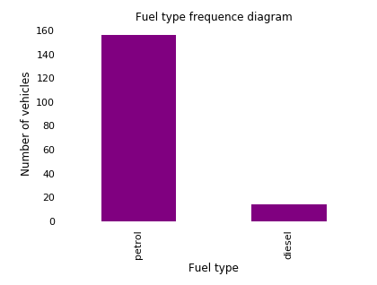
Exploratory Data Analysis
Visualisation
Most of the cars have petrol as a fuel type.
Count of vehicles with petrol as a fuel type
is around 160 and with diesel 20.

Slide 6
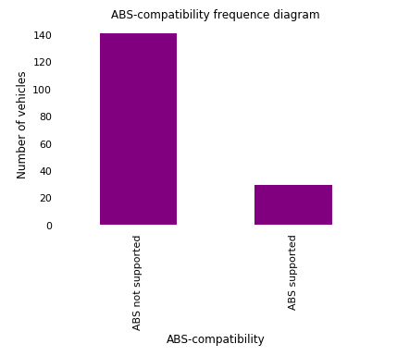
Exploratory Data Analysis
Most of the vehicles are not supported with
ABS-compatibility. Count of vehicles with
ABS-compatibility not supported is around 140
and supported is 20.

Slide 7
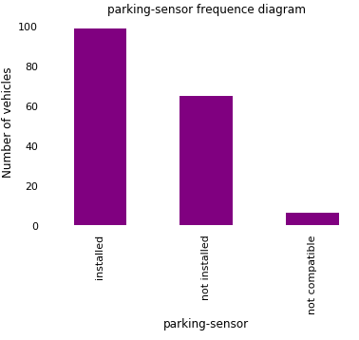
Exploratory Data Analysis
Count of vehicles are as below:
Installed parking sensor around 100
Uninstalled parking sensor around 60
Parking sensor not compatible around 10.

Slide 8
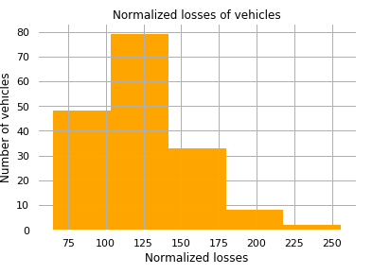
Exploratory Data Analysis
Average loss payment per insured vehicle
which is normalized loss is positively skewed.

Slide 9
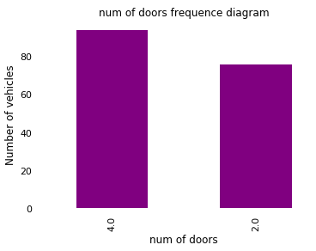
Exploratory Data Analysis
Count of vehicles with 4 doors are around 100
and with 2 doors are 70.

Slide 10
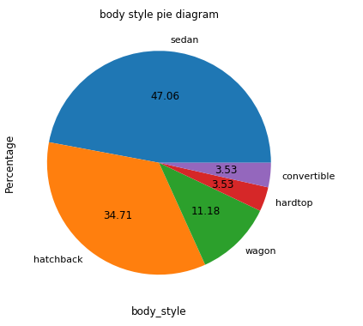
Exploratory Data Analysis
Car body type features are as below:
Sedan is at the higher-end around 47.06
Hatchback around 34.71 percentage
Wagon 11.18 percentage
Hardtop 3.53 percentage
Convertible 3.53 percentage.

Slide 11
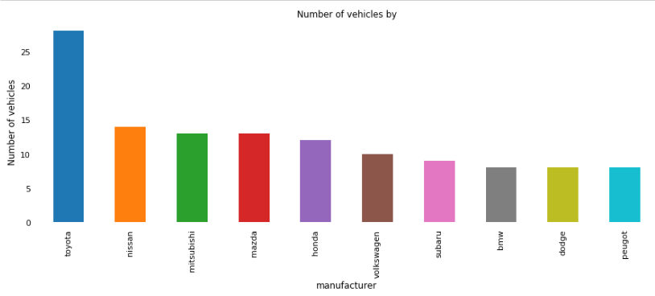
Exploratory Data Analysis
Vehicles manufactured are as below:
By Toyota around 30
Nissan, Mitsubishi, Mazda , Honda around 15
Volkswagen, Subaru , BMW , Dodge, Peugot around 10.

Slide 12
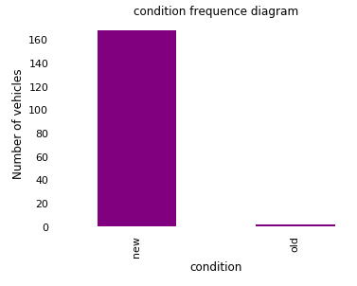
Exploratory Data Analysis
Count of vehicles which are in new condition
are around 160 and in old condition 2.

Slide 13
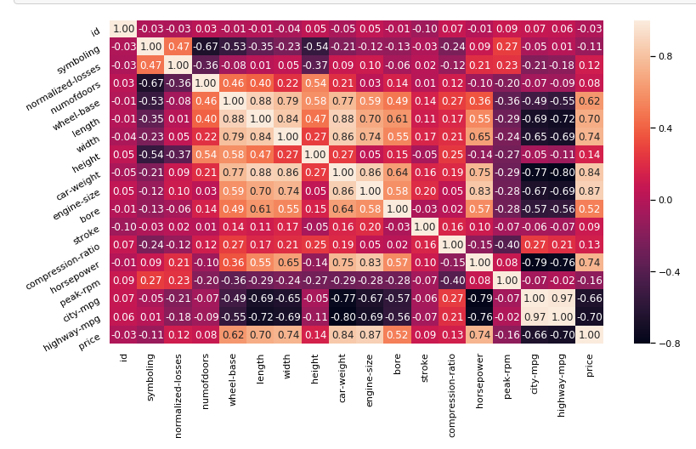
Exploratory Data Analysis Correlation plot

Slide 14
Exploratory Data Analysis
Strong positive relationship between car weight and width
Strong positive relationship between engine size and price
Strong positive relationship between car weight and price
Strong positive relationship between horse power and engine size
Strong positive relationship between car weight and engine size
Strong positive relationship between car weight and wheel base
Strong positive relationship between wheel base and width
Strong positive relationship between length and wheel base

Slide 15
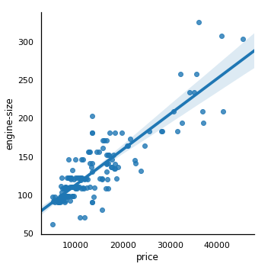
Exploratory Data Analysis
Engine size and price represents a positive relationship.
Higher will be the engine size, Higher will be the price.

Slide 16
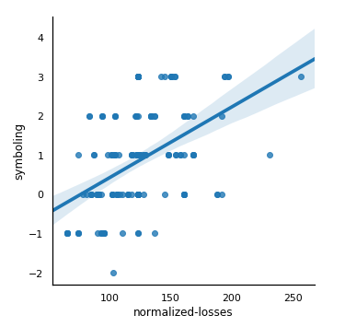
Exploratory Data Analysis
Lesser will be the insurance risk rating, Lesser
Will be the normalised loss.

Slide 17
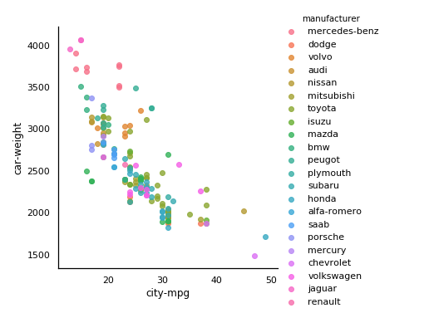
Exploratory Data Analysis
City mpg is inversely proportional to
the car weight.
Heavier the automobile, lesser will be the
city mpg.

Slide 18
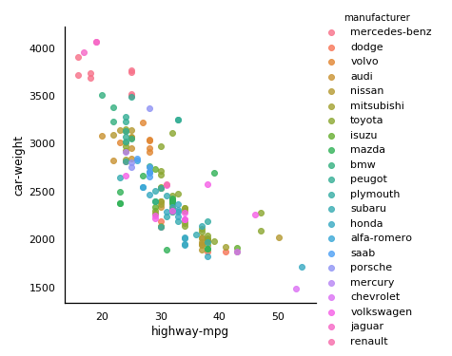
Exploratory Data Analysis
Highway-mpg is inversely proportional to
the car weight.
Heavier the automobile, lesser will be the
Highway mpg.

Slide 19
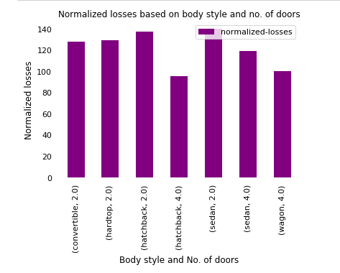
Exploratory Data Analysis
Normalized losses are distributed across different body styles
and number of doors.
Cars with two doors have more normalized losses than cars
With 4 doors.

Slide 20
Exploratory Data Analysis
Dummy variables are created for fuel , ABS Compatibility , parking sensor , body style , manufacturer , condition , engine type , number of person , and battery type using get dummies function from Pandas.

Slide 21
Modelling
Linear Regression Algorithm is used to make predictions for prices from sklearn library.

Slide 22
Model Evaluation
Mean Square log Error is used to compare actual and predicted prices.
Lower Mean Square log error is estimated which is 0.2345.

Slide 23
Final Submission
In Final Submission bins are created for prices to categorise it into low , medium and higher categories.

Slide 24
Libraries Used
Numpy
Pandas
Matplotlib
Sklearn

